Slide 1
Introduction to Programming
Dynamic Memory Allocation

Slide 2
Dynamic Memory Allocation
Dynamically allocated memory is determined at runtime rather than at compilation.
A program may create as many or as few variables as required, offering greater flexibility.
Dynamic allocation is often used to allow creation of arrays whose size is only known at runtime.
Etter/Ingber PSH/JKL

Slide 3
Dynamic Memory Allocation
Dynamic memory is finite (depends on how much memory is installed in the computer).
Dynamically allocated memory may be freed during program execution.
Etter/Ingber PSH/JKL

Slide 4
Dynamic Memory Allocation
Memory is allocated using the:
  malloc function
  calloc function
Memory is released using the:
  free function
The size of memory requested by malloc or calloc can be changed (reallocated) using the:
  realloc function
Etter/Ingber PSH/JKL

Slide 5
malloc and calloc
Both functions return a pointer to the newly allocated memory.
If memory cannot be allocated, the value returned will be a NULL value.
The pointer returned by these functions is declared to be a void pointer.
A type-cast operator should be used with the returned pointer value to coerce it to the proper pointer type.
Etter/Ingber PSH/JKL

Slide 6
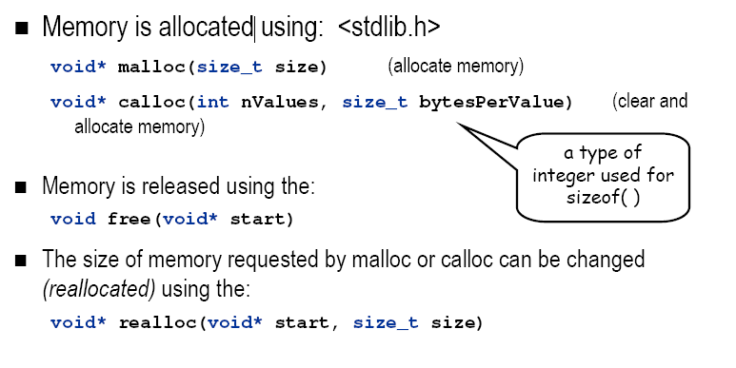
Dynamic Memory Allocation
Etter/Ingber PSH/JKL

Slide 7
size
size is the number of bytes to be allocated.
  calloc( ) calculates it as nValues*bytesPerValue
calculate by multiplying the number of bytes per value by the number of values.
  nValues * sizeof(type)
  e.g.
  200 * sizeof(double)
  - allocates 3200 bytes
Etter/Ingber PSH/JKL

Slide 8
void*
The pointer returned by malloc, calloc and realloc is declared to be a void pointer.
void * is a general-purpose pointer variable type.
Unlike int *, double *, char *.
It has no "sizeof" – arrays will not be able to access the values correctly, so it must be cast to int *, double * or char *.
If memory can not be allocated, the value returned will be a NULL value.
Etter/Ingber PSH/JKL

Slide 9
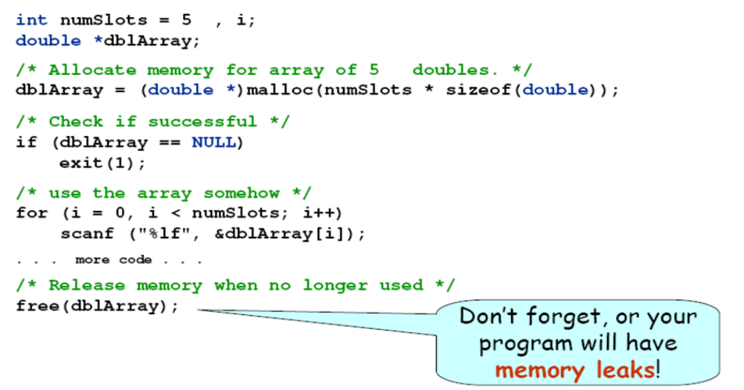
malloc and free example
Etter/Ingber PSH/JKL

Slide 10
Example memfiller.c
/* memFiller.c Fills up dynamic memory by creating arrays at runtime. */
#include <stdio.h>
#include <stdlib.h>
int main(void) {
const int arraySize = 10000;
double *dblArray = NULL; /* array to create at runtime */
int numArrays = 0; /* number of arrays created */
do { /* Create array dynamically and do NOT free(dlbArray) */
dblArray = (double *)malloc(arraySize * sizeof(double));
numArrays++;
} while (dblArray != NULL); /* stop when creation of array fails */
printf("Ran out of space creating the %dth array of 10000 numbers.\n", numArrays);
return 0;
}
Etter/Ingber PSH/JKL

Slide 11
Example Etter6_5 – fixed
/* Program chapter6_5 Declare array fixed */
#include <stdio.h>
#define FILENAME "seismic.dat"
#define MAX_SIZE 1000
int main(void) {
int k, npts, short_window, long_window;
double sensor[MAX_SIZE], time_incr, short_power, long_power, ratio;
FILE *file_ptr;
file_ptr = fopen(FILENAME,"r");
if (file_ptr == NULL) { printf("Error opening input file\n"); }
else {
fscanf(file_ptr, "%i %lf", &npts, &time_incr); // get number points
if (npts > MAX_SIZE) { // check npts against size of sensor[]
printf("Data file too large for array. \n");
return 1;}
else { for(k=0; k<=npts-1; k++)
fscanf(file_ptr, “%lf”, &sensor[k]);}
Etter/Ingber PSH/JKL

Slide 12
Example Etter6_5 – dynamic
/* Program chapter6_5 Declare array dynamically */
#include <stdio.h>
#define FILENAME "seismic.dat"
// #define MAX_SIZE 1000 – no max size
int main(void) {
int k, npts, short_window, long_window;
double *sensor, time_incr, short_power, long_power, ratio; // pointer
FILE *file_ptr;
double power_w(double *ptr, int n);
file_ptr = fopen(FILENAME,"r");
if (file_ptr == NULL) { printf("Error opening input file\n"); }
else {
fscanf(file_ptr, "%i %lf", &npts, &time_incr); // get number points
sensor = (double *)malloc(npts*sizeof(double)); // create array
if (sensor == NULL) { // check if array successful
printf("Data file too large for memory. \n");
return 1;}
else { for(k=0; k<=npts-1; k++)
fscanf(file_ptr, “%lf”, &sensor[k]);}
Etter/Ingber PSH/JKL

